Slide 1

STOCKTIGO
“Fit the entire stock market in a Box”

Slide 2
PROBLEM
SOLUTION
Not knowing when and where to start learning about the stock market
Learning about the very basic fundamentals of stock market very late in their carriers
To spark an early interest in the stock market
Combining a childhood activity with the fundaments of stock market

Slide 3
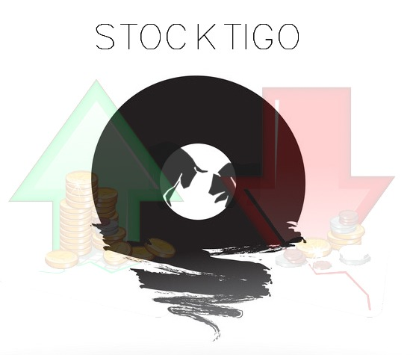
PRODUCT

Slide 4
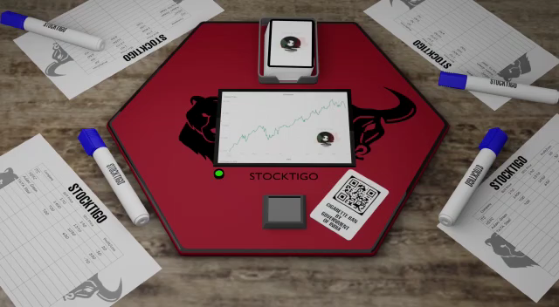

Slide 5
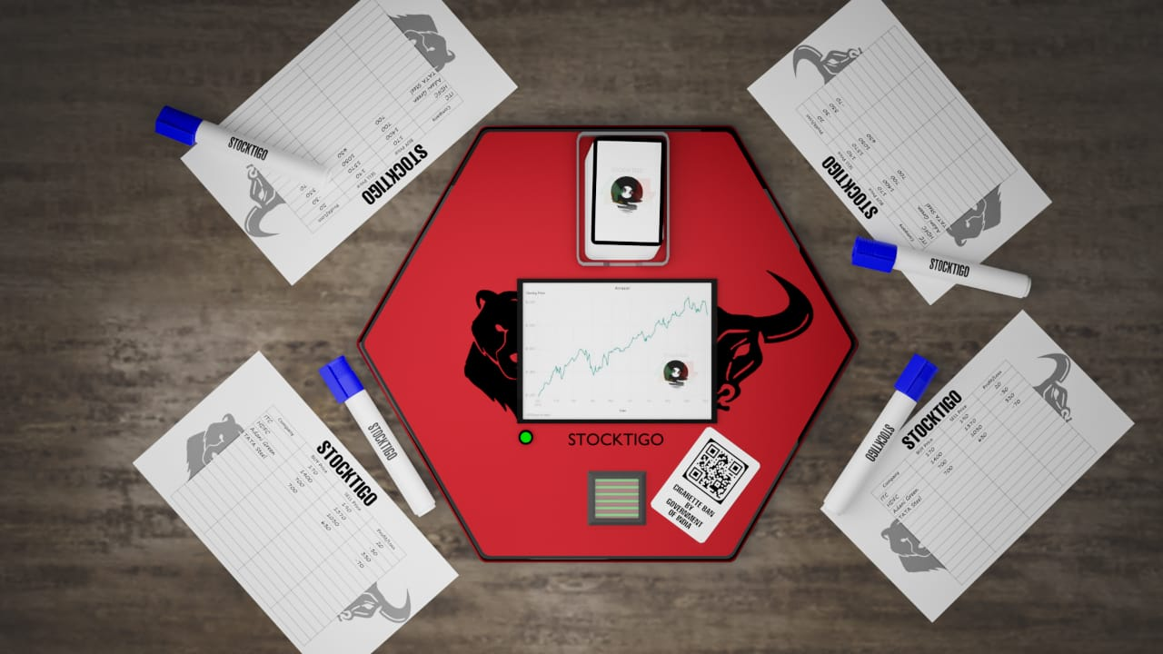
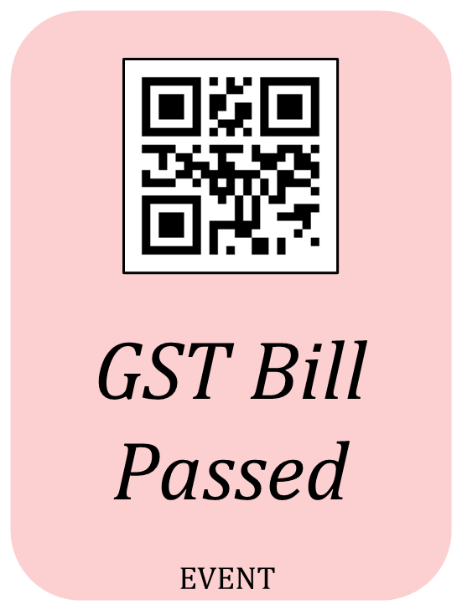
A - 83 | B - 62 | D - 755
E - 257 | F - 822 | G - 955
H - 327 | I - 617 | J - 1015
A - 85 | B - 65 | D - 750
E - 260 | F - 820 | G - 960
H - 330 | I - 620 | J - 1020
SEN STOCK | FIFTY 50 | S&Q 600
S&Q LargeCap | S&Q SmallCap | S&Q MidCap
S&Q IT | S&Q FMCG | S&Q Energy
COMPANY | BUY PRICE | SELL PRICE | PROFIT/ LOSS
B | 65
D | 750 | 750 | 0
J | 1020 | 1020 | 0
I | 620
COMPANY | BUY PRICE | SELL PRICE | PROFIT/ LOSS
B | 65
D | 750
J | 1020

Slide 6

VISION
MISSION
VALUES
“Our mission is to provide the complex knowledge of stock markets in the easiest way possible and provide a start for young minds on their market journey”
“We operate by following honesty, customer services and determination as our guiding principles”
“To empower individuals with the knowledge of financial markets & boost financial literacy”

Slide 7
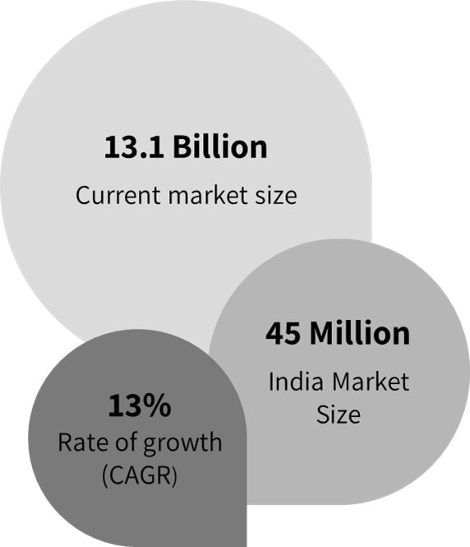
INDUSTRY OVERVIEW
Size of the global board game industry
Source: Arizton

Slide 8
BUSINESS MODEL CANVAS
KEY PARTNERS
KEY ACTIVITIES
VALUE PROPOSITIONS
CUSTOMER RELATIONSHIPS
CUSTOMER SEGMENTS
Campus Components Pvt Ltd
Shree Raj Hans Printers
Amazon
Xtreme Ads
R&D
Marketing
An opportunity to learn about the fundamentals of the stock market in a fun way
Warranty
Customer Service
Kids (10+)
Young Adults
Mass Market
KEY RESOURCES
CHANNELS
Technology
Human Resource
Retail Distribution
E-commerce
COST STRUCTURE
REVENUE STREAMS
Electronic Components
Outsourcing Expenses
Marketing & Sales
Profit on product sales

Slide 9
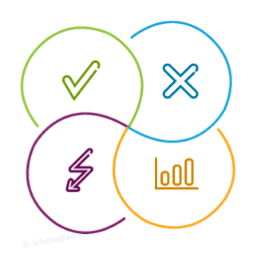
SWOT ANALYSIS

Slide 10
Big competitors like Hasbro & Funskool
High dependency on outsourcing
Continuous threat by advent of electronic alternatives
Less control over production & cost
New company, no market share
Inexperienced management
STRENGTHS
OPPORTUNITIES
Innovation – screen, software
Combining education and fun
Stock market boom
WEAKNESS
Govt. aims to promote India as toy hub
WFH increased indoor activities
Increase in digitalization in various sectors
No substantial innovation in this sector by competitors
THREATS

Slide 11

MARKETING

Slide 12



ADVERTISING WHAT PLATFORMS ARE WE GOING TO USE?
XTREME ADS
PPC, Google Ads, Facebook Ads, SEO
AMAZON ADVERTISING
Amazon’s Sponsored Products
YOUTUBE
Influencer Marketing:
DearSir, Intellectual Indies, Pebbles Live & more

Slide 13
MARKETING & SALES STRATEGY
E-commerce
Advertising
₹ 44,91,200
Estimated Cost
Brick & Mortar

Slide 14
MARKETING MILESTONES
6
MONTHS
Estimated sales: 270 units
Amazon Advertising
Reach out to more influential youtubers
2
YEAR
Estimated sales: 1,850 units
AGGRESSIVE
1
YEAR
Estimated sales: 900 units
PASSIVE-AGGRESSIVE
AGGRESSIVE
Monthly collaborations with YouTube channels
Heavy initial investment in social media advertising
Reduce spending on YouTube collaborations
More emphasis on e-commerce advertising

Slide 15

FINANCIALS

Slide 16
COST STRUCTURE
1st Year
Material
Cost
20.25 L
Manufacturing Cost
51%
3.40 L
9%
Marketing
Cost
Selling& Distribution Cost
₹ 39,55,823
Estimated Cost
4.29 L
11%
5.16 L
13 %
Rent & Warehouse
3.08 L
8%
Miscellaneous
3.35 L
8%

Slide 17
Linked to Excel

Slide 18
DIVERSIFICATION
New Products
New Technology
EXPANSION
STRATEGY
(10 year plan)
INTEGRATION
Backward Vertical Integration – Set up own manufacturing unit
DIGITALIZATION
Mobile App
Educational Courses

Slide 19
EXIT
STRATEGY
Target Met
Target Lost
MERGER
Merge with a huge board game company increasing our operations and sales
LIQUIDATION
Liquidate our company and dissolute all our stock and assets

Slide 20


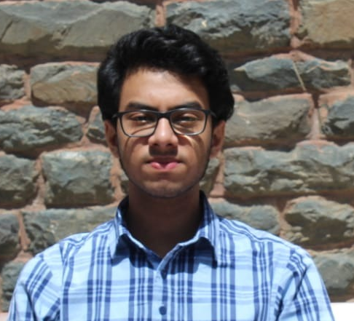


THE TEAM
NATASHA MACHADO
ISHAN GARG
RISHABH SOOD
RIA CHOPRA
HARSH ARORA

Slide 21
THANK
YOU

